Slide 1

Claims / Billing
Hamaspik Choice MLTC
Ver 05-2024

Slide 2
Goals for this presentation
UNDERSTAND:
Claims Submission Process
Submission Timeframes
Required Claim Fields
Claim Denials
Resubmissions
Claims Status Inquiries
Payments & Remittance Notices

Slide 3

How to submit claims
Format:
Professional claims: CMS-1500 or electronic equivalent
Institutional claims: UB-04 or electronic equivalent
Method:
Electronically thru clearinghouse (AVAILITY)
Payer ID: 47738
Paper claims mailed to:
Hamaspik Managed Care • PO Box 20408 • Tampa, FL 33622

Slide 4

Submission Timeframes
Contract-specific
Generally, 120 days from dates of service

Slide 5
Required Fields on Claims

Slide 6
Goal is to match the claim to the authorization for smooth adjudication:
Authorization Number
Provider NPI
Provider Taxonomy Code
Provider Tax ID
Hamaspik Choice Member ID
CPT or HCPCS codes that match the authorization
Units
Dates of Service
Place of Service (POS) Codes
Diagnosis Code(s)
Hamaspik includes a diagnosis code on all authorizations.

Slide 7
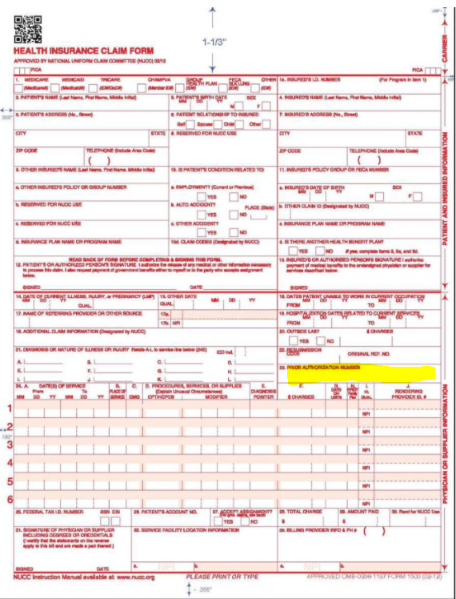
CMS-1500 Professional
Claim Form
Box 23 must have Authorization Number

Slide 8

Claim Denials • Common Reasons
Omitting authorization number from the claim
Referencing wrong authorization number
Billing codes that differ from what was authorized
Past timely filing
Incorrect or missing member or provider
Incorrect or missing date of service
Incorrect or missing unit(s)
Incorrect or missing Diagnosis code
Service interruption on file for dates of service of claim for duplication of service

Slide 9
Resubmissions
For claims that have already been PAID but need to be modified:
Must be resubmitted within 60 days of EOP
CMS-1500 or electronic equivalent
  Specify value “7” in box/field 22 in order for it not to be considered a duplicate claim, e.g. additional units or codes on already paid claim
  Enter previous claim number as “Original Reference Number” in box 22
UB-04 or electronic equivalent
  Change bill type to reflect claim resubmission
  Indicate original claim number in box/field 64
Electronic is best!

Slide 10
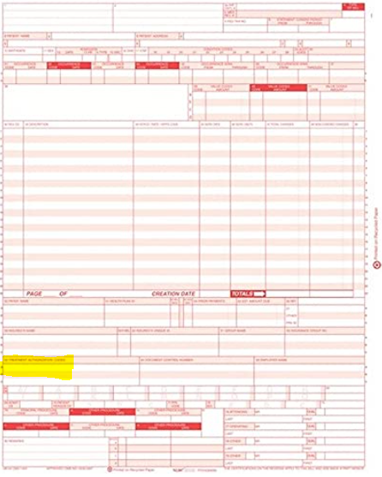
UB-04 Institutional
Claim Resubmission of claim already paid
Bill type should indicate that it is a resubmission.
Box 63 must have original claim number.

Slide 11
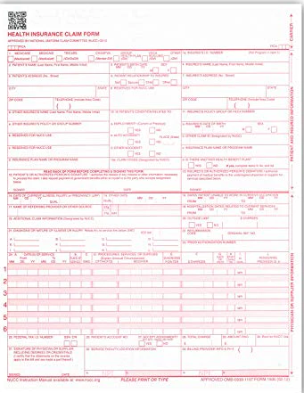
CMS-1500 Professional Claim
Resubmission of claim already paid
Box 22
should have value of “7” plus original claim reference number.

Slide 12
Resubmitting claims that were entirely denied
Resubmit as a standard claim
Keep in mind timely filing timeframes

Slide 13
Payments & Remittance Notices
Payments
Payments for MLTC services are made electronically
Each MLTC provider already provided ACH banking information at the time of contracting (if change needed, contact Provider Relations Dept.
Payment is made within 30 days for electronic claims and 45 days for paper claims
Remittance NOTICES/EXPLANATIONS OF PAYMENT (EOP)
Electronic Remittance Advice (ERA) for those providers who enrolled to receive HIPAA 835s thru the clearinghouse are issued on Fridays
Inquiries regarding Remittance Notices should go to Remittances@hamaspikchoice.org

Slide 14

Compliance
Proof of services may be requested as part of routine audits by Hamaspik’s Compliance Dept.
Home Care Services—Electronic Visit Verification (EVV) system utilization is mandatory
Social Adult Day Care—Member sign-in sheets or electronic sign-in proof necessary

Slide 15
thank you
Hamaspik Choice
ClaimsProcessing@hamaspikchoice.org
www.hamaspik.com

